Slide 1

Transforming the Home Improvement Industry
We're revolutionizing the way homeowners and contractors approach home improvement projects. Discover how our platform empowers users, mitigates risks, and creates new revenue streams.
By BG30

Slide 2

Unveiling the Power of Our Platform: Benefits for All
End-User Satisfaction
Contractor Efficiency
Simplify the DIY process and empower homeowners to confidently plan and execute projects with ease.
Streamline project planning and management with our comprehensive platform, offering a centralized hub for material sourcing and supply chain management.
Startup Growth
Expand market reach and unlock new revenue streams by accessing a vast network of potential customers through our online marketplace.

Slide 3
Empowering Homeowners: A Seamless DIY Experience
Effortless Planning
Real-Time Budget Control
Our platform centralizes all necessary materials, providing price comparisons, quality ratings, and honest reviews for informed decision-making.
Calculate project costs accurately and efficiently with real-time price updates and budget tracking, ensuring transparency and financial control.

Slide 4



Contractor Planning Assistance: Mitigating Risk & Ensuring Success
Price Locking
Inventory Management
Secure materials at fixed prices and ensure project affordability by locking in costs and safeguarding against market fluctuations.
Our system provides real-time inventory updates, ensuring availability of essential materials when needed, preventing delays and project disruptions.

Slide 5
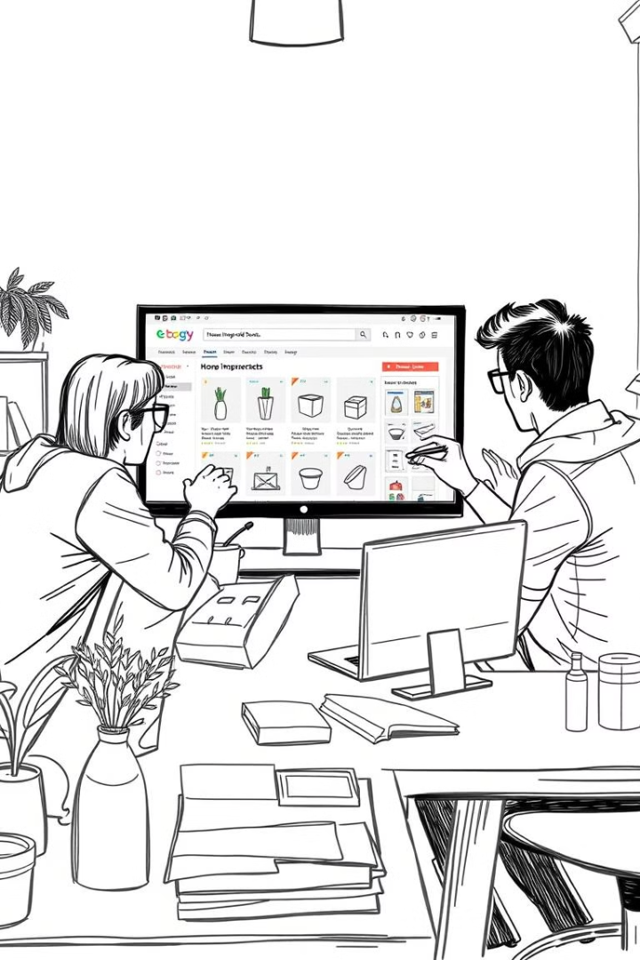


Expanding Revenue Streams: Empowering Startups & Businesses
Consignment Feature
List products and gain exposure to a nationwide audience, increasing sales potential and driving business growth.
Reduced Overheads
Eliminate traditional costs associated with physical exhibitions and retail space, optimizing resources and maximizing profitability.

Slide 6
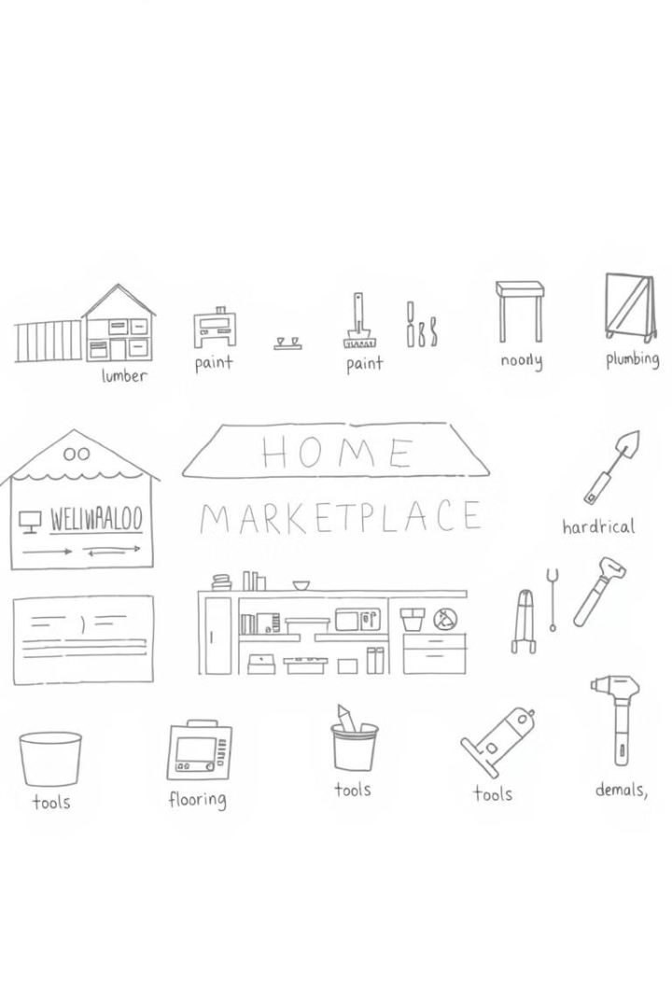
Unparalleled Variety and Convenience: A One-Stop Shop
Diverse Materials
Centralized Platform
Access a wide range of high-quality materials from various suppliers, catering to diverse needs and project requirements.
Find everything you need in one place, simplifying the procurement process and saving valuable time and effort.

Slide 7



Driving Innovation and Growth: Shaping the Future of Home Improvement
Customer Satisfaction
1
Delivering exceptional experiences and building lasting relationships with our user base.
Industry Leadership
2
Establishing ourselves as a leading force in the home improvement sector, driving innovation and setting new standards.
Sustainable Growth
3
Continuing to expand our reach and impact, fostering a thriving ecosystem of businesses and customers.

Slide 8

Invest in a Visionary Future: Partner with Us
1
2
Innovation
Growth
We're constantly developing cutting-edge features and technologies to enhance user experience and industry efficiency.
Our platform is experiencing significant growth and expansion, creating opportunities for investors and partners.

